Slide 1
The Chemical Basis of Morphogenesis
Group 1 – 13.12.2019

Slide 2
Have you ever wondered how .... ?

Slide 3
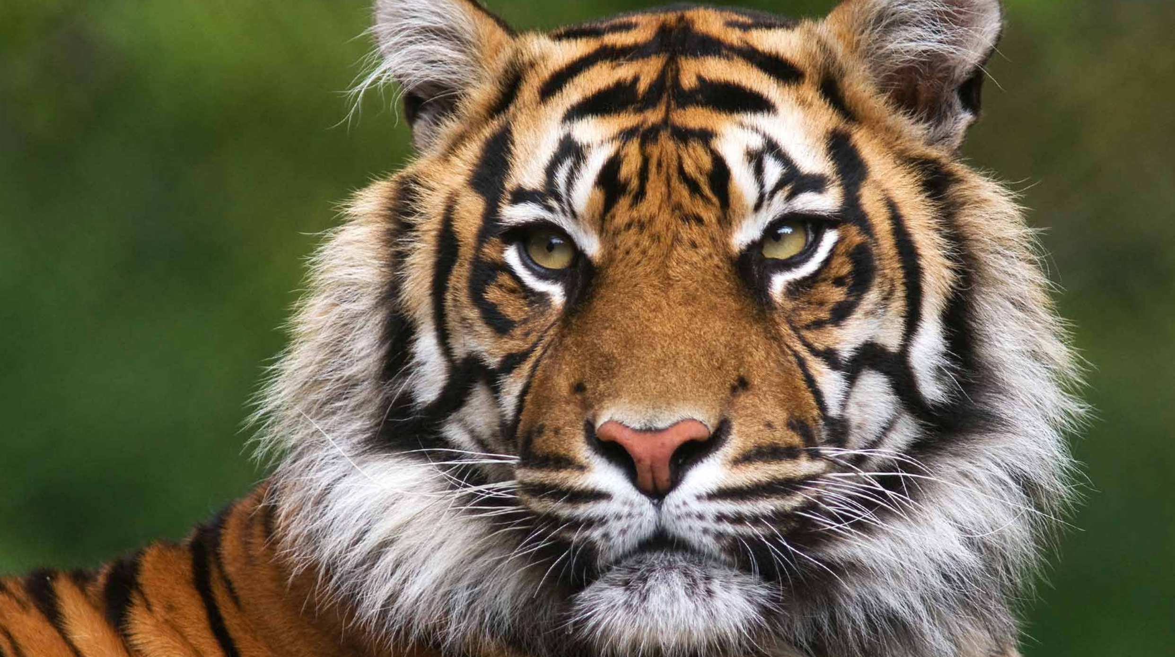
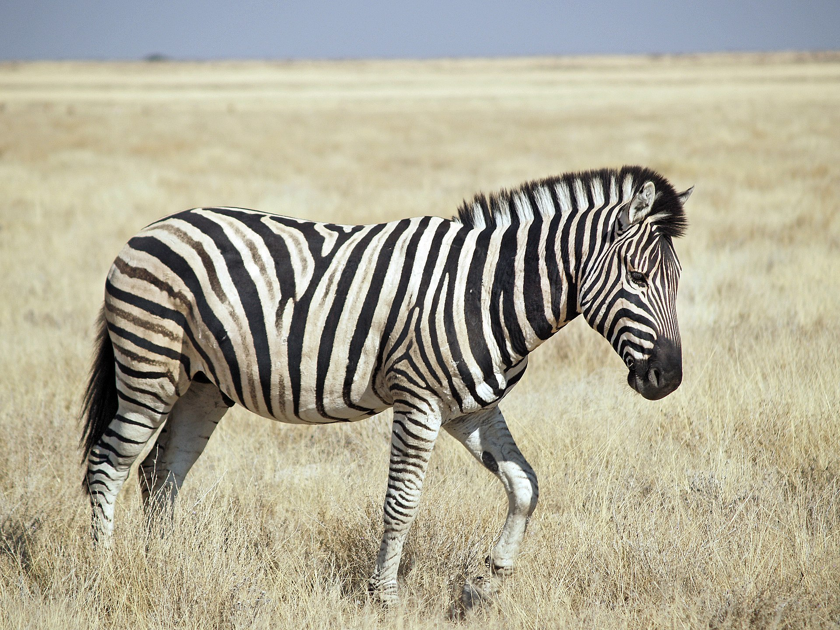
Have you ever wondered how .... ?
900 × 900

Slide 4
Have you ever wondered how .... ?
... animals get their patterns?
900 × 900

Slide 5

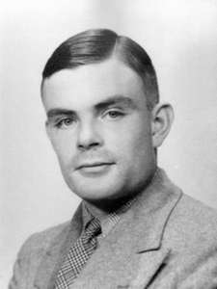
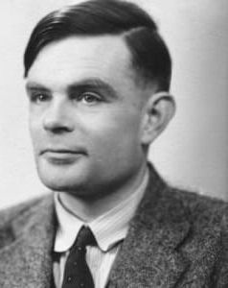
Alan Mathison Turing

Slide 6
Alan Mathison Turing
Britisch mathematician

Slide 7
Alan Mathison Turing
Britisch mathematician
Helped cracking intercepted coded messages during WWII

Slide 8
Alan Mathison Turing
Britisch mathematician
Helped cracking intercepted coded messages during WWII
Foundational research of computer science

Slide 9
Alan Mathison Turing
Britisch mathematician
Helped cracking intercepted coded messages during WWII
Foundational research of computer science
Author of todays lecture «The Chemical Basis of Morphogenesis»

Slide 10
Structure
Introduction
Turing‘s famous paper
Main idea
3 Approaches
Excursions
Patterns
Hydra
Research today
Crowd Simulations
Take Home

Slide 11
Video on patterns!

Slide 12
Introduction
Morphogenesis

Slide 13
Introduction
Morphogenesis
Greek: morphê = shape
genesis = creation
«beginning of the shape»

Slide 14
Introduction
Morphogenesis
Greek: morphê = shape
genesis = creation
«beginning of the shape»
Morphogens

Slide 15
Introduction
Morphogenesis
Greek: morphê = shape
genesis = creation
«beginning of the shape»
Morphogens
Turing: «... a system of chemical substances reacting together and diffusing through a tissue.»

Slide 16
Reaction-Diffusion System
VI Stationary waves of finite wave-length:
greatest interest
most biological application
Notes:
Three or more morphogens, otherwise case I.
A wave pattern is maintained by a system that has reached dynamic equilibrium (where the morphogens continue to move and react but there is no net change in the overall state). The pattern’s wavelength (the distance between the “peaks” of the wave) is determined by how the molecules react and rates at which they diffuse (Figure 4).

Slide 17
Turing‘s question
How can chemicals, which simply diffuse through the fluid medium that contains them, give rise to order and structure?
Since
Notes:
Stable state can be equilibrium or steady state
We wont differ from equilibrium or steady state
Example: 1. Bathtub/Fountain
2. Ink in a bottle of water
Steady state but one which varies in space, resulting in a spatially inhomogeneous pattern

Slide 18
Turing‘s question
How can chemicals, which simply diffuse through the fluid medium that contains them, give rise to order and structure?
Since
1. Chemical reactions at some point will reach a stable state
Notes:
Stable state can be equilibrium or steady state
We wont differ from equilibrium or steady state
Example: 1. Bathtub/Fountain
2. Ink in a bottle of water
Steady state but one which varies in space, resulting in a spatially inhomogeneous pattern

Slide 19
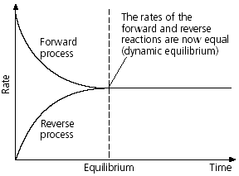
Turing‘s question
How can chemicals, which simply diffuse through the fluid medium that contains them, give rise to order and structure?
Since
1. Chemical reactions at some point will reach a stable state
2H₂+ O₂ ⇄ 2H₂O
Notes:
Stable state can be equilibrium or steady state
We wont differ from equilibrium or steady state
Example: 1. Bathtub/Fountain
2. Ink in a bottle of water
Steady state but one which varies in space, resulting in a spatially inhomogeneous pattern

Slide 20
Turing‘s question
How can chemicals, which simply diffuse through the fluid medium that contains them, give rise to order and structure?
Since
1. Chemical reactions at some point will reach a stable state
2. Diffusion at some point will reaches a stable state
Notes:
Stable state can be equilibrium or steady state
We wont differ from equilibrium or steady state
Example: 1. Bathtub/Fountain
2. Ink in a bottle of water
Steady state but one which varies in space, resulting in a spatially inhomogeneous pattern

Slide 21
Turing‘s question
How can chemicals, which simply diffuse through the fluid medium that contains them, give rise to order and structure?
Since
1. Chemical reactions at some point will reach a stable state
2. Diffusion at some point will reaches a stable state
But looking at both combined, there is no stable state!
there is instability.
There is neither a homogenous nor a chaotic state, but something in between: a pattern.
Notes:
Stable state can be equilibrium or steady state
We wont differ from equilibrium or steady state
Example: 1. Bathtub/Fountain
2. Ink in a bottle of water
Steady state but one which varies in space, resulting in a spatially inhomogeneous pattern

Slide 22
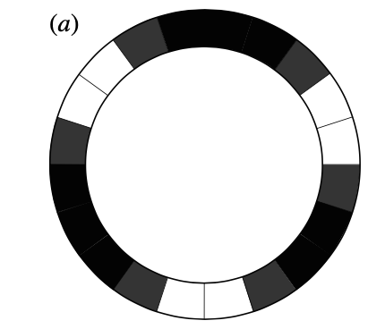
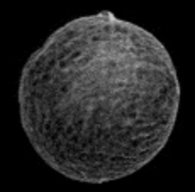
Reaction-Diffusion Systems
For mathematical convenient reasons, Turing looked at his reaction-diffusion systems either as a isolated ring of cells or as continuous ring of tissue.
Turing uses mathematical equations to model biological processes, like cell and organism growth.
The investigation is chiefly concerned with the onset of instability.
Two or three morphogens
It is found that there are six essentially different forms which this may take.
Those system are mostly unusable in biological system
Notes:
Fouriere and linear Differential Equations.

Slide 23
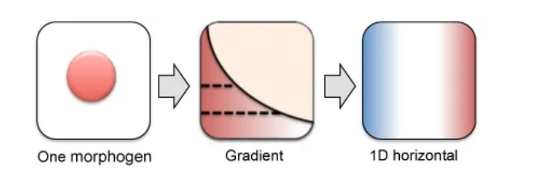
Reaction-Diffusion Systems
One morphogen
Notes:
Figure 2. Hypothetical system in the reaction-diffusion model. Each cell produces, and is capable of responding to, two morphogens (red-colored triangles and blue-colored diamonds). The morphogens diffuse into the space around the cells at different rates, bind to their respective receptors (same colors) and either stimulate or inhibit their own production. The final distribution of morphogens results in a specific pattern. (Image based on [3]).
Both morphogens can spread away (or “diffuse”) from where they are originally produced in the tissue. One morphogen diffuses slowly, and serves as an activator of development at nearby sites. The second morphogen is an inhibitor of the first, and spreads more rapidly from where it originated, thus acting at longer ranges. It is the interaction (or “reaction”) of these two morphogens that allows for the autonomous generation of spatial patterns during development.

Slide 24
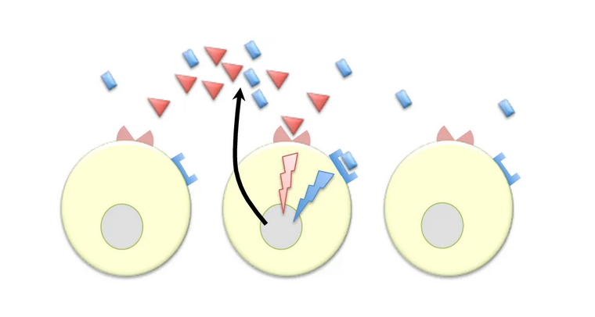
Reaction-Diffusion Systems
Two morphogens (Blue & Red)
Blue diffuses slowly, and serves as an activator of development at nearby sites.
Red is an inhibitor of the first, and spreads more rapidly from where it originated, thus acting at longer ranges.
Notes:
Figure 2. Hypothetical system in the reaction-diffusion model. Each cell produces, and is capable of responding to, two morphogens (red-colored triangles and blue-colored diamonds). The morphogens diffuse into the space around the cells at different rates, bind to their respective receptors (same colors) and either stimulate or inhibit their own production. The final distribution of morphogens results in a specific pattern. (Image based on [3]).
Both morphogens can spread away (or “diffuse”) from where they are originally produced in the tissue. One morphogen diffuses slowly, and serves as an activator of development at nearby sites. The second morphogen is an inhibitor of the first, and spreads more rapidly from where it originated, thus acting at longer ranges. It is the interaction (or “reaction”) of these two morphogens that allows for the autonomous generation of spatial patterns during development.

Slide 25
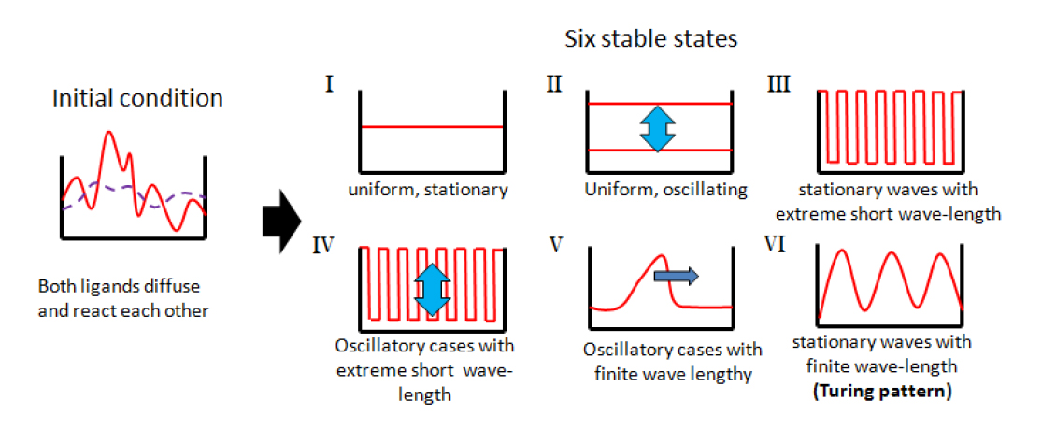
Reaction-Diffusion Systems
Notes:
The contents of all the cell are the same; no resultant flow from cell to cell due to diffusion, so that each is behaving as if it were isolated. Each is in unstable equilibrium, and slips out of it in synchronism with the others. All cells are the same, behaving as if each were in isolation. Eg, mixing two food colorings to a cup of water changes the water to a single hue of color. Domino effect
(a) The equilibrium concentrations and reaction rates may be come such that there would be instability for an isolated cell with the same content as any one of the cells of the ring. If that cell drifts away from the equilibrium position, like an upright stick falling over, then, in the ring, each cell may be expected to do liltewise. I n neighbouring cells the drift may be expected to be in the same direction, but in distant cells, e.g. at opposite ends of a diameter there is no reason to expect this to be so.
This is the least interesting of the cases. It is possible, however, that it might account for 'dappled ' colour patterns, and an example of a pattern in two dimensions produced by this type of process is shown in figure 2 for comparison with 'dappling'. If dappled patterns are to be explained in this way they must be laid down in a latent form when the foetus is only

Slide 26
Reaction-Diffusion Systems
I Stationary case with extreme long wave-length
Notes:
The contents of all the cell are the same; no resultant flow from cell to cell due to diffusion, so that each is behaving as if it were isolated. Each is in unstable equilibrium, and slips out of it in synchronism with the others. All cells are the same, behaving as if each were in isolation. Eg, mixing two food colorings to a cup of water changes the water to a single hue of color. Domino effect
(a) The equilibrium concentrations and reaction rates may be come such that there would be instability for an isolated cell with the same content as any one of the cells of the ring. If that cell drifts away from the equilibrium position, like an upright stick falling over, then, in the ring, each cell may be expected to do liltewise. I n neighbouring cells the drift may be expected to be in the same direction, but in distant cells, e.g. at opposite ends of a diameter there is no reason to expect this to be so.
This is the least interesting of the cases. It is possible, however, that it might account for 'dappled ' colour patterns, and an example of a pattern in two dimensions produced by this type of process is shown in figure 2 for comparison with 'dappling'. If dappled patterns are to be explained in this way they must be laid down in a latent form when the foetus is only

Slide 27
Reaction-Diffusion Systems
I Stationary case with extreme long wave-length
most extremely featureless form of pattern
Notes:
The contents of all the cell are the same; no resultant flow from cell to cell due to diffusion, so that each is behaving as if it were isolated. Each is in unstable equilibrium, and slips out of it in synchronism with the others. All cells are the same, behaving as if each were in isolation. Eg, mixing two food colorings to a cup of water changes the water to a single hue of color. Domino effect
(a) The equilibrium concentrations and reaction rates may be come such that there would be instability for an isolated cell with the same content as any one of the cells of the ring. If that cell drifts away from the equilibrium position, like an upright stick falling over, then, in the ring, each cell may be expected to do liltewise. I n neighbouring cells the drift may be expected to be in the same direction, but in distant cells, e.g. at opposite ends of a diameter there is no reason to expect this to be so.
This is the least interesting of the cases. It is possible, however, that it might account for 'dappled ' colour patterns, and an example of a pattern in two dimensions produced by this type of process is shown in figure 2 for comparison with 'dappling'. If dappled patterns are to be explained in this way they must be laid down in a latent form when the foetus is only

Slide 28
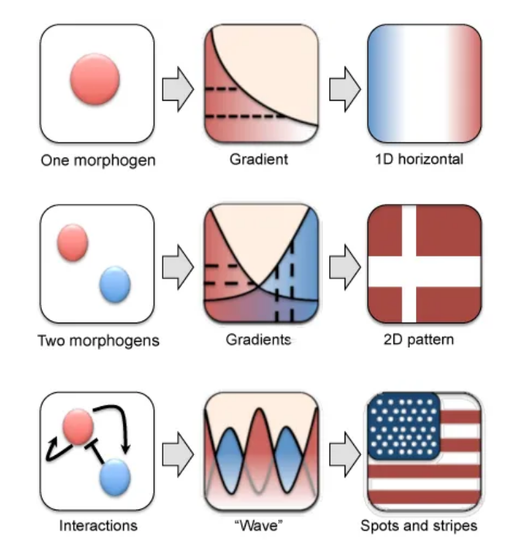
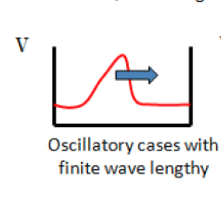
Reaction-Diffusion System
V Oscillatory case with a finite wave-length
genuine travelling waves
Three or more morphogens,
Notes:
This is the case which is of greatest interest, and has most biological application
Three or more morphogens, otherwise case I.
(This scenario requires at least three morphogens, as two morphogens may only result in a stationary pattern (Figure 3B-C). Eg, movement of a slinky at one end propagates itself until it reaches the opposite end.)
Morphogen-gradient models and reaction-diffusion model. (A) A single morphogen provides positional information to cells based on the concentration of the molecule it “sees”, depending on how far the cells are from the morphogen source (the dotted lines represent different concentration thresholds that provide different instructions to the cells). (B) Two morphogens allow for the formation of more complex patterns that depend on the concentrations of both, however, the system is entirely dependent on the initial positional information and cannot regulate itself. (C) Interaction between two morphogens allow for the system to be self-regulated, and consequently, capable of forming a plethora of patterns that are independent of the initial conditions of the system. (Image based on [3]).

Slide 29
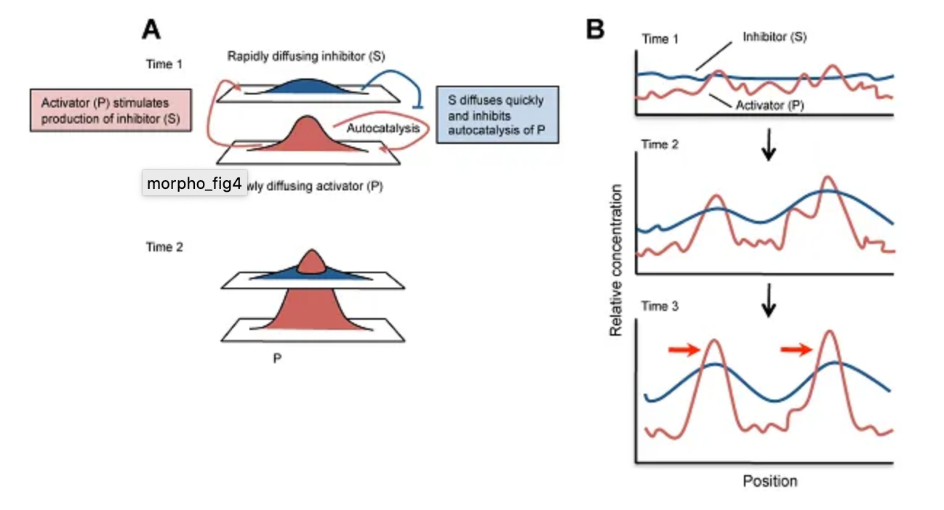
Reaction-Diffusion System
VI Stationary waves of finite wave-length:
greatest interest
most biological application
Notes:
Three or more morphogens, otherwise case I.
A wave pattern is maintained by a system that has reached dynamic equilibrium (where the morphogens continue to move and react but there is no net change in the overall state). The pattern’s wavelength (the distance between the “peaks” of the wave) is determined by how the molecules react and rates at which they diffuse (Figure 4).
(A) The conditions of the model yield a peak of the slowly diffusing activator (P) and a lower peak of the rapidly diffusing inhibitor (S) at the same location. (B) The distribution of the morphogens is initially random. As the concentration of activator (P) increases locally, it stimulates the production of more of itself (called “autocatalysis”), as well as of the inhibitor (S) which diffuses away quickly to inhibit more peaks of P from forming, resulting in a series of P peaks (red arrows) at regular intervals whose positions don’t change with time (a “standing wave”). (Image based on [5]).

Slide 30
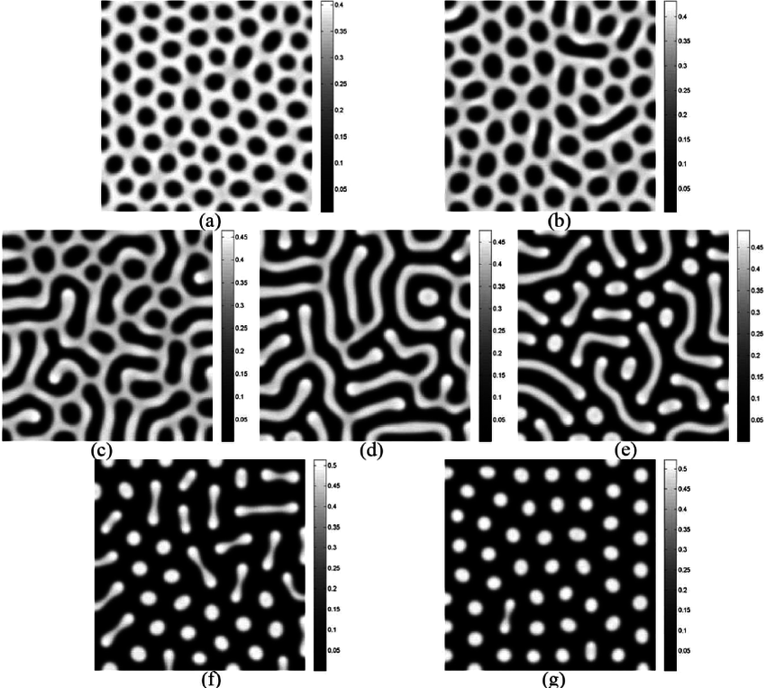
Excursion: Turing patterns
https://www.researchgate.net/figure/Typical-Turing-patterns-of-N-in-model-4-with-parameters-b-0-25-g-0-50-d-1-0_fig2_231021430

Slide 31
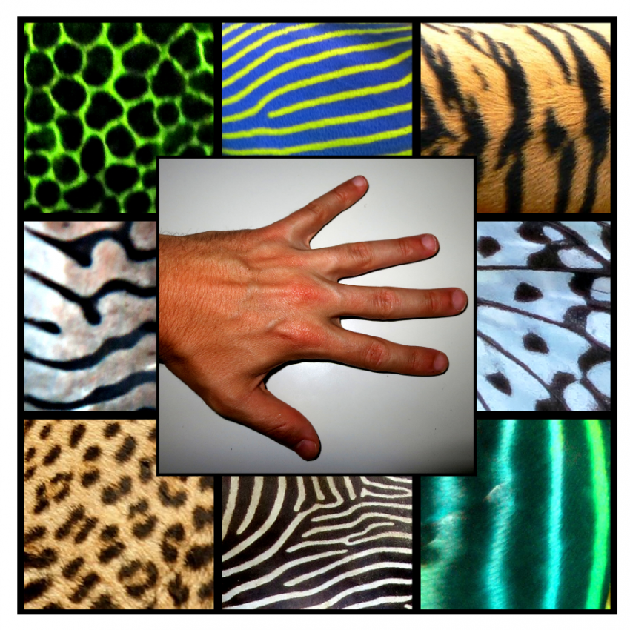
What did he propose in terms of patterning?
https://phys.org/news/2014-07-mathematical-theory-alan-turing-formation.html

Slide 32
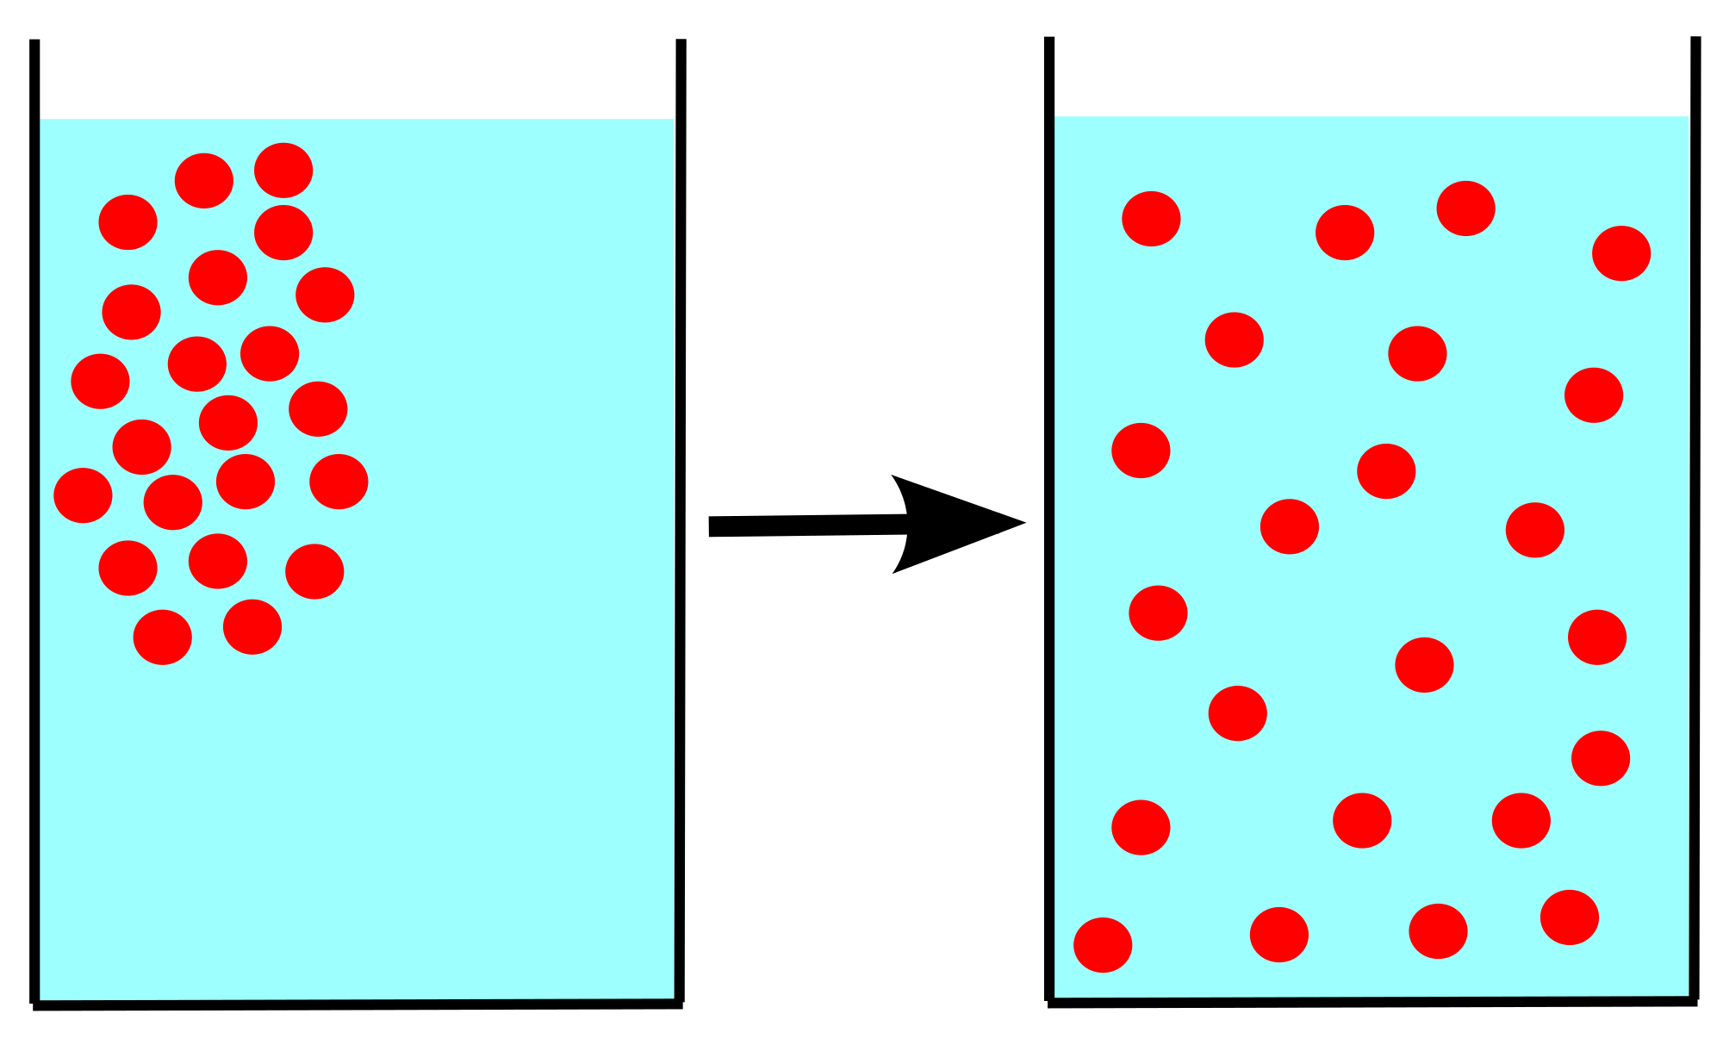
What are morphogenes?
Key points on morphogenes:
Diffusing substances
Reacting with one another
System is called reaction-diffusion system
https://de.wikipedia.org/wiki/Datei:Diffusion.svg

Slide 33
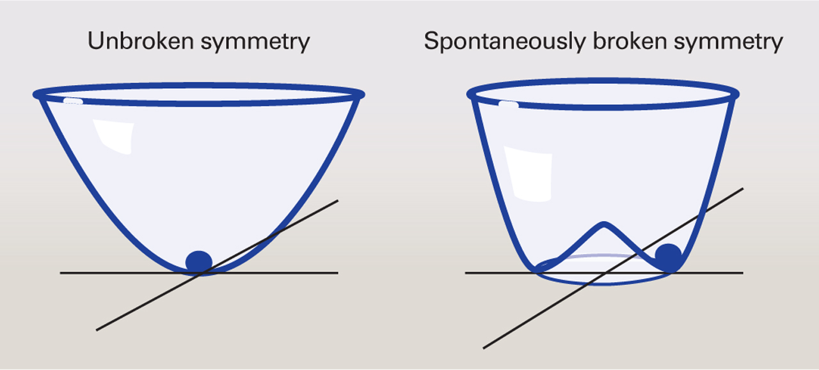
Turings key points on patterns:
What he tried to show:
How animal markings are formed
Symmetry breaking in fertilised eggs
That morphogenes given the right circumstances could exist
https://science.sciencemag.org/content/337/6100/1289

Slide 34
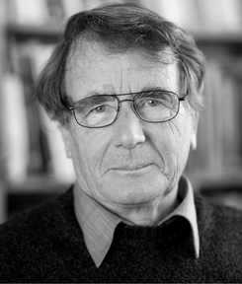
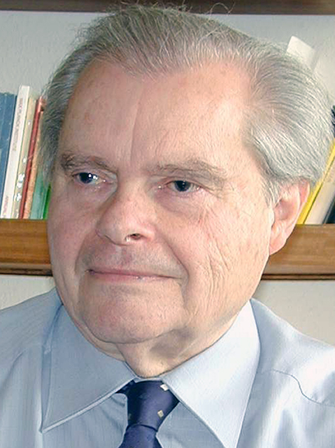
How was the paper received at the time and how were the morphogenes finally understood?
Alfred Gierer
Hans Meinhardt
https://dev.biologists.org/content/143/8/1231
http://www.bbaw.de/Mitglieder/MitgliedDetails?fm_id=407

Slide 35
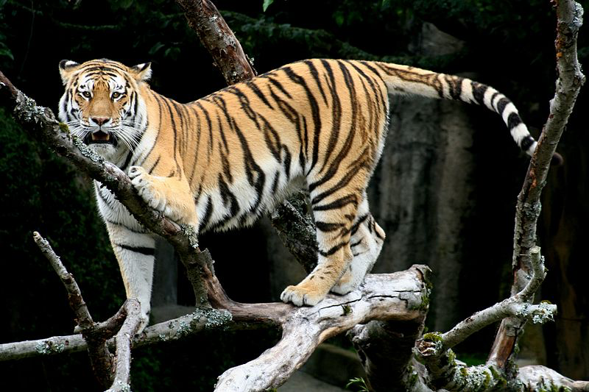
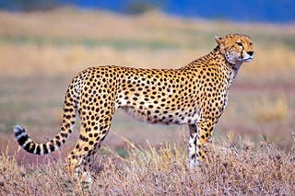
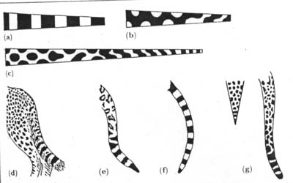
http://applet-magic.com/murray2.htm

Slide 36
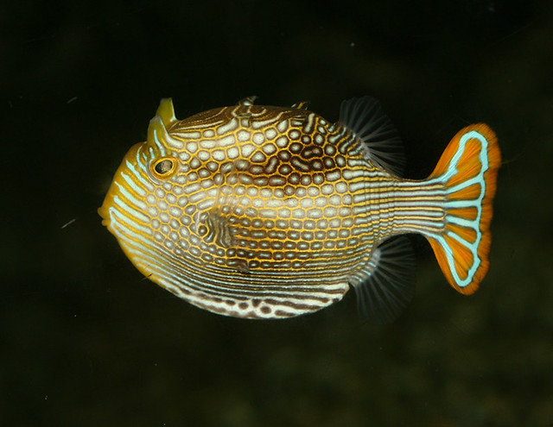
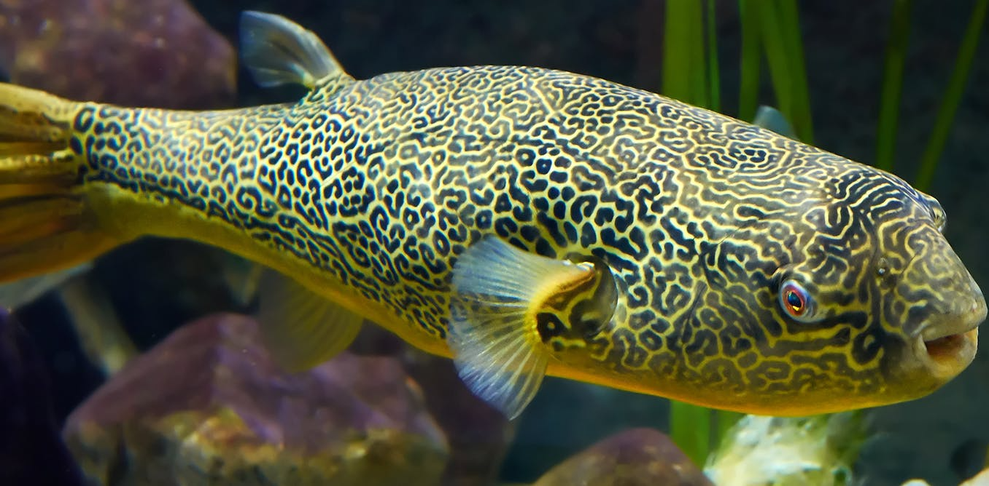
https://www.flickr.com/photos/xinmincat/413375656/
http://theconversation.com/alan-turing-how-the-worlds-most-famous-codebreaker-unlocked-the-secrets-of-natures-beauty-119425

Slide 37
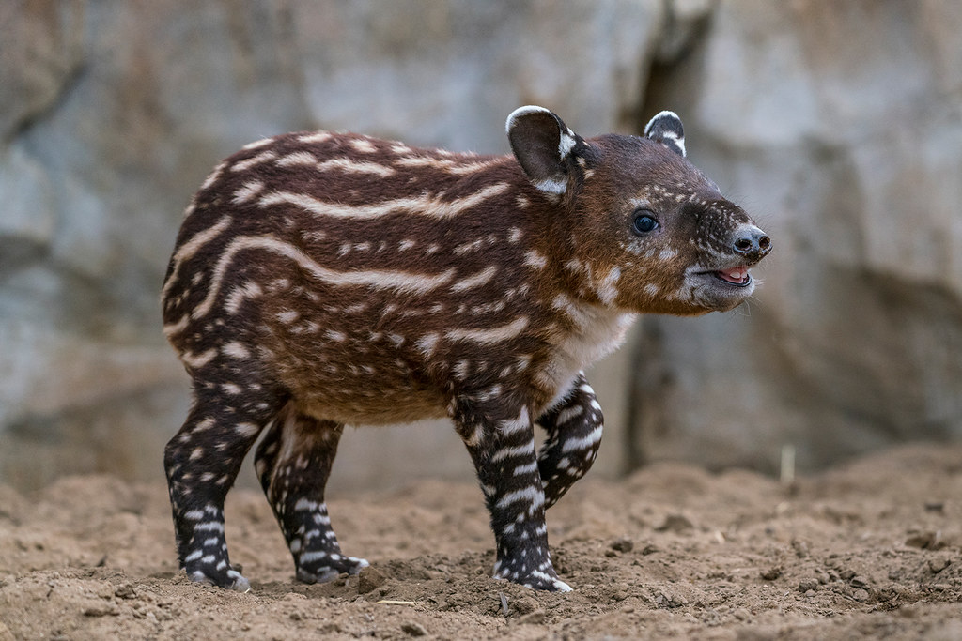
EXCEPTIONS EXCEPTIONS - The Tapir -
https://www.flickr.com/photos/sdzooglobal/43175034024

Slide 38
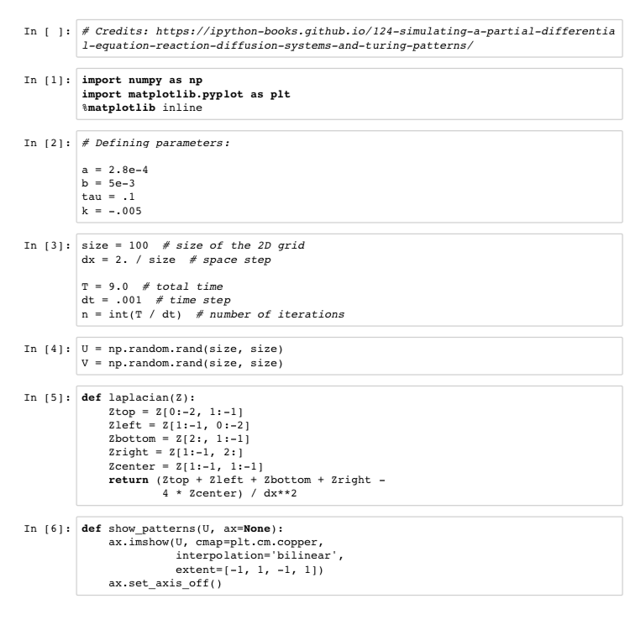
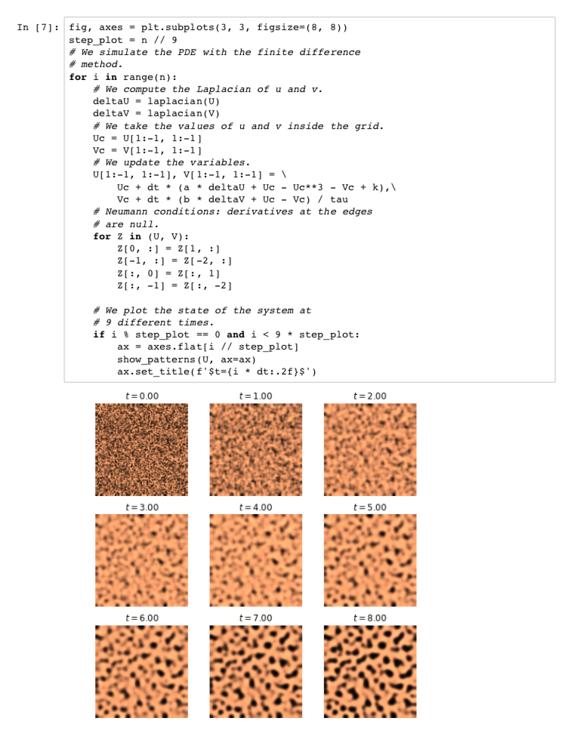
Pattern simulation:
https://ipython-books.github.io/124-simulating-a-partial-differential-equation-
reaction-diffusion-systems-and-turing-patterns/

Slide 39
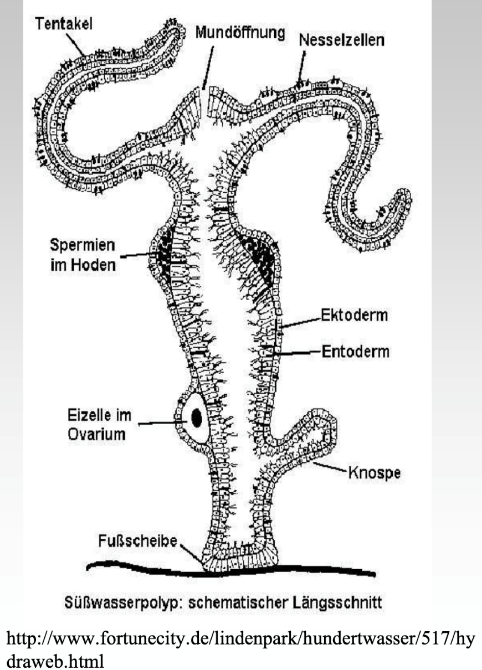
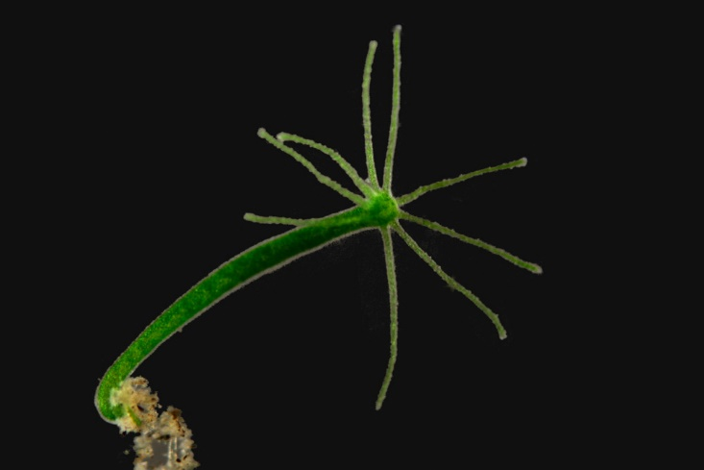
Excursion: Hydra

Slide 40
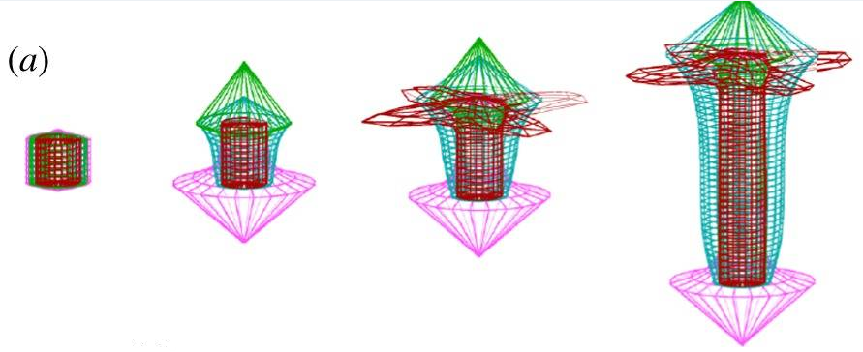
Excursion: Hydra
https://www.ncbi.nlm.nih.gov/pmc/articles/PMC3363033/

Slide 41
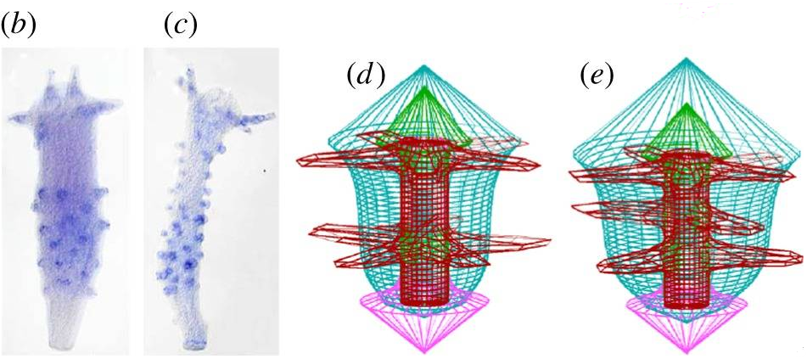
Excursion: Hydra
https://www.ncbi.nlm.nih.gov/pmc/articles/PMC3363033/

Slide 42
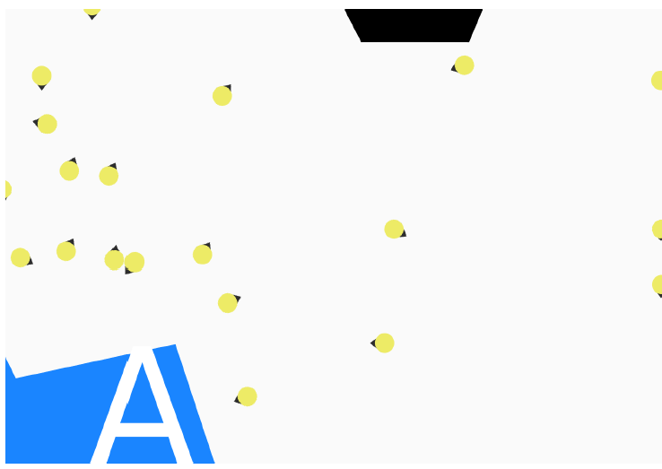
Research today: Crowd Simulation
Webster and Amos

Slide 43
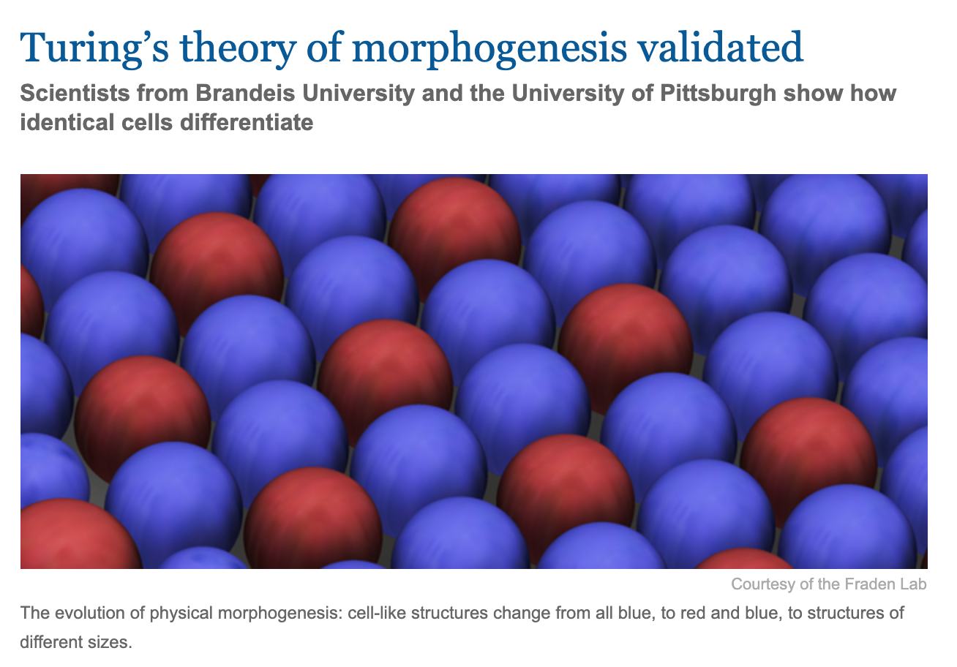
Impact today

Slide 44
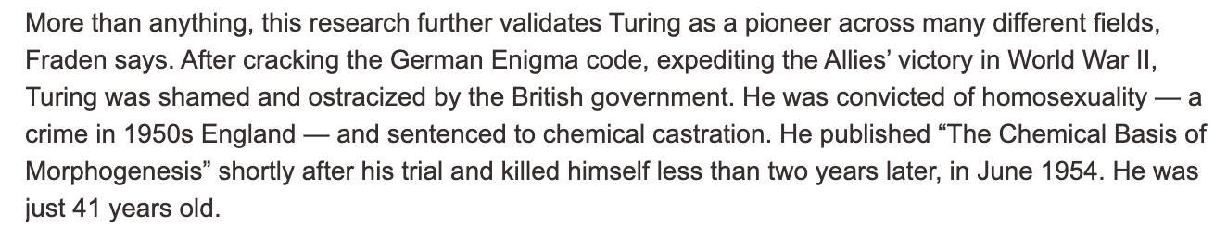
Impact today

Slide 45
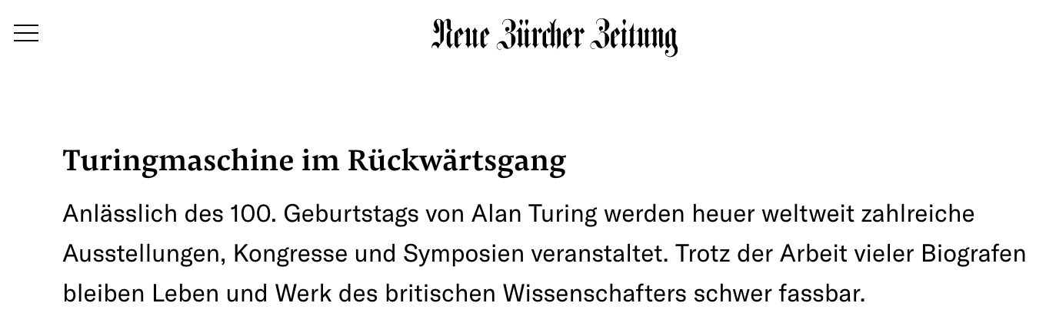
Impact today

Slide 46
Take Home

Slide 47
Take Home
Pioneering paper
No understanding of the paper in the beginning
Adaptions needed (food for thought)
Mathematic models (not always biologically correct)
Few references

Slide 48
Sources
http://www.bbaw.de/Mitglieder/MitgliedDetails?fm_id=407
https://www.biography.com/scientist/alan-turing
https://www.britannica.com/biography/Alan-Turing
https://dev.biologists.org/content/143/8/1231
https://www.ncbi.nlm.nih.gov/pmc/articles/PMC3363033
https://phys.org/news/2014-07-mathematical-theory-alan-turing-formation.html
https://www.researchgate.net/figure/Typical-Turing-patterns-of-N-in-model-4-with-parameters-
b-0-25-g-0-50-d-1-0_fig2_231021430
https://science.sciencemag.org/content/337/6100/1289
https://www.turing.org.uk/
https://en.wikipedia.org/wiki/Alan_Turing
https://de.wikipedia.org/wiki/Datei:Diffusion.svg

Slide 49
Thank you for your attention.

